Slide 1
18AIE424T- ARTIFICIAL INTELLIGENCE AND INTERNET OF THINGS
2024 -25 ODD Sem

Slide 2
UNIT 1
Principles of IOT and AI, Fundamentals of IOT and AI, Definition of IOT, IOT reference model, IOT Platforms, IOT verticals, Big Data and IOT, Infusion of AI and IOT, The standard process in data mining, IOT Platforms and AI Platforms, Introduction to Datasets, Tensorflow, Keras, Dataset Examples, Data Access and distributed processing for IOT, Text files in python, SQL data, HDF5

Slide 3
What is IOT?
The term IoT was coined by Kevin Ashton in 1999.
The IoT refers to the network of physical devices embedded with sensors, software, and other technologies that collect and exchange data.
These devices connect to the internet, enabling them to communicate with other devices and systems.
Examples of IoT devices include smart home appliances, wearables, industrial sensors, and connected vehicles.

Slide 4
Definition of IOT
The International Telecommunication Unit (ITU), a United Nations agency, defines IoT as:
"a global infrastructure for the information society, enabling advanced services by interconnecting (physical and virtual) things based on existing and evolving interoperable information and communication technologies."

Slide 5
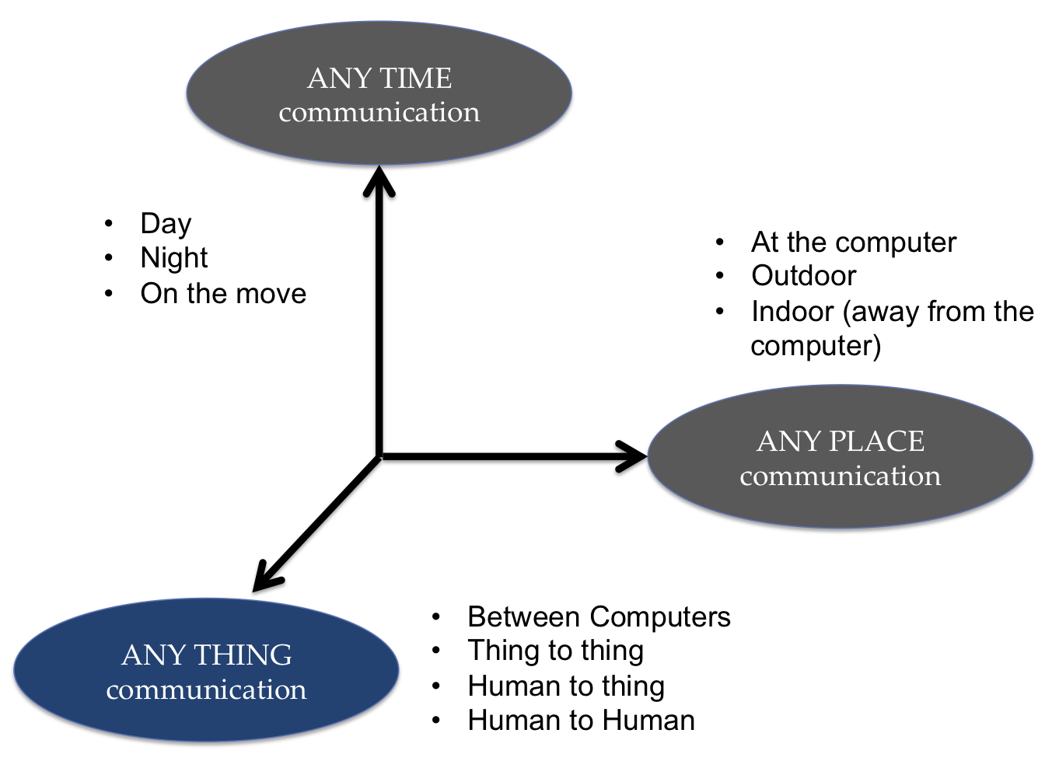
Dimension of IOT

Slide 6
Principles of IoT and AI
IoT and AI are complementary technologies.
IoT focuses on connecting devices and gathering data.
AI focuses on analyzing data and making intelligent decision
Connectivity: Seamless connection of devices.
Data: Collection and management of data.
Analytics: Analyzing data to extract valuable insights.
Intelligence: Using AI to make informed decisions.
Automation: Automating processes based on AI decisions.
Scalability: Ability to scale IoT systems.

Slide 7
Integration of IoT and AI
IoT devices generate vast amounts of data.
AI algorithms analyze this data to provide insights.
Example: Smart homes using IoT sensors and AI for automation

Slide 8
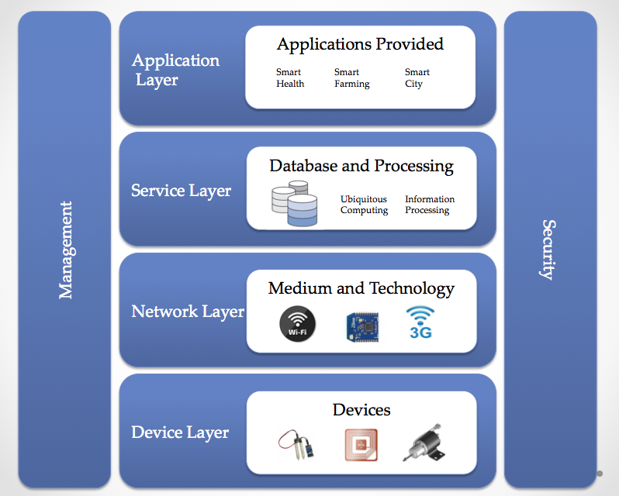
IoT reference model

Slide 9
Just like the OSI reference model for the internet, IoT architecture is defined through six layers: four horizontal layers and two vertical layers.
The two vertical layers are Management and Security and they're spread over all four horizontal layers.

Slide 10
The Device Layer:
At the bottom of the stack, we have the device layer, also called the perception layer. This layer contains the physical things needed to sense or control the physical world and acquire data (that is, by perceiving the physical world).
Existing hardware, such as sensors, RFID, and actuators, constitutes the perception layer.
The Network Layer:
This layer provides the networking support and transfer of data over either wired or wireless network.
The layer securely transmits the information from the devices in the device layer to the information processing system.
Both transmission Medium and Technology are part of the networking layer. Examples include 3G, UMTS, ZigBee, Bluetooth, Wi-Fi, and so on.
The Service Layer:
This layer is responsible for service management. It receives information from the network layer, stores it into the database, processes that information, and can make an automatic decision based on the results.
The Application Layer:
This layer manages the applications dependent upon the information processed in the service layer. There's a wide range of applications that can be implemented by IoT: smart cities, smart farming, and smart homes, to name a few.

Slide 11
IOT Platforms
IoT platforms provide a set of tools and services to manage IoT devices and data.
They act as middleware that connects hardware and application layers.
Facilitate device connectivity, data collection, processing, and visualization.
Device Management: Onboarding, configuration, and monitoring of devices.
Data Management: Collection, storage, and analysis of data.
Connectivity: Support for various communication protocols (WiFi, Bluetooth, etc.).
Security: Data encryption, access control, and authentication.
Scalability: Ability to handle a large number of devices and data.

Slide 12
IoT platform can be chosen according to the following criteria:
Scalability: Addition and deletion of new devices to the existing IoT network should be possible
Ease of use: The system should be perfectly working and delivering all its specifications with minimum intervention
Third party integration: Heterogeneous devices and protocols should be able to inter-network with each other
Deployment options: It should be workable on a broad variety of hardware devices and software platforms
Data security: The security of data and devices is ensured

Slide 13
Challenges in Using IoT Platforms
Integration Complexity: Integrating with existing systems can
be difficult.
Data Privacy: Ensuring data privacy and compliance with regulations.
Security Risks: Protecting against cyber threats and vulnerabilities.
Scalability Issues: Managing large-scale deployments effectively.
Vendor Lock-in: Risk of being tied to a single vendor's ecosystem.

Slide 14
IOT verticals
IoT verticals refer to specific industries and sectors where
IoT technology is applied.
Each vertical has unique applications and benefits from IoT integration.
Common IoT verticals include Smart Home, Healthcare, Industrial IoT,
Smart Cities, Agriculture, and Retail.

Slide 15
IoT enables the possibility of many such verticals, and some of the top IoT verticals are as follows:
Smart building : Data is collected via these smart devices and sensors to remotely monitor a building, energy, security, landscaping, HVAC, lighting, and so on. The data is then used to predict actions, which can be automated according to events and hence efficiency can be optimized, saving time, resources, and cost.
Smart agriculture: Sensors placed through the farm can help in automating the process of irrigation
Smart city: A smart city has the capability to address traffic, public safety, energy management, and more for both its government and citizens.
Connected Healthcare: Individuals carry medical sensor to monitor body parameters such as heartbeat, body temperature, glucose level, and so on. The wearable sensors, such as accelerometers and gyroscopes, can be used to monitor a person's daily activity.

Slide 16
Big Data and IOT
Definition of Big Data:
Big Data refers to large, complex datasets that traditional
data processing software cannot manage efficiently.
Intersection of IoT and Big Data:
IoT devices generate massive amounts of data,
contributing to the Big Data landscape.
This data can be analyzed for insights to drive decision-making,
improve operations, and create new business models.

Slide 17
How IoT Generates Big Data
Data Generation:
IoT devices such as sensors, cameras, and smart meters continuously collect
data.
Example: A smart city’s sensors collect data on traffic, air quality, and
energy usage.
Characteristics of IoT Data:
Volume: Large amounts of data generated in real-time.
Velocity: High speed at which data is generated and processed.
Variety: Different types of data including structured, semi-structured,
and unstructured data.

Slide 18
Data Sources:
Wearables: Health data from fitness trackers.
Smart Homes: Usage data from smart appliances.
Industrial IoT: Machine performance data from manufacturing equipment.
Agricultural IoT: Soil and weather data from farming sensors.

Slide 19
Benefits:
Enhanced Decision-Making: Analyzing IoT data helps organizations make
informed decisions.
Predictive Maintenance: Predict failures and perform maintenance
before issues occur.
Operational Efficiency: Optimize processes and improve productivity.
Personalization: Tailor services and products to individual
customer preferences.
Innovative Solutions: Create new products and business models
based on data insights.

Slide 20
Challenges
Data Security and Privacy: Ensuring the protection of sensitive data.
Data Management: Handling the volume, velocity, and variety of data.
Integration: Combining IoT data with existing systems and data sources.
Data Quality: Ensuring the accuracy and reliability of collected data.
Scalability: Managing the increasing number of IoT devices and data volume.

Slide 21
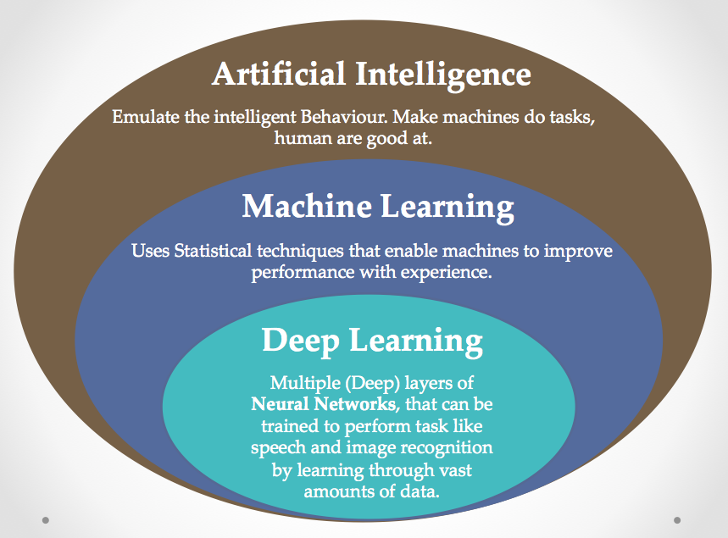
Infusion of AI – data science in IoT
IoT generates an enormous amount of data; presently, 90% of the data generated isn't even captured, and out of the 10% that is captured, most is time-dependent and loses its value within milliseconds.

Slide 22
AI (Artificial Intelligence) and IoT (Internet of Things) are two
transformative technologies that, when combined, have the potential to
revolutionize various industries.
AI refers to the simulation of human intelligence processes by machines,
enabling them to learn from data, adapt to new situations,
and perform tasks autonomously.
IoT involves connecting everyday objects to the internet,
allowing them to send and receive data, facilitating real-time monitoring,
control, and automation.

Slide 23
Definition
The intersection of AI and IoT refers to the integration of artificial intelligence
algorithms and techniques with IoT devices and systems.
AI enhances IoT applications by enabling devices to analyze data, make
intelligent decisions, and take autonomous actions without human intervention.

Slide 24
Examples
Smart Home: AI-powered virtual assistants (e.g., Amazon Alexa,
Google Assistant) analyze IoT sensor data to automate home functions
like adjusting thermostats, controlling lighting, and managing appliances
based on user preferences.
Industrial IoT: AI algorithms analyze data from sensors installed in
manufacturing equipment to optimize production processes, predict equipment
failures, and enable predictive maintenance.
Healthcare: Wearable IoT devices equipped with AI algorithms monitor
patients' health metrics in real-time, detect anomalies, and provide
personalized health recommendations.

Slide 25
By observing the behavior of multiple things, IoT (with the help of big data and AI) aims to gain insight into the data and optimize underlying processes.
This involves multiple challenges:
Storing real-time generated events
Running analytical queries over stored events
Performing analytics using AI/ML/DL techniques over the data to gain insights and make predictions

Slide 26
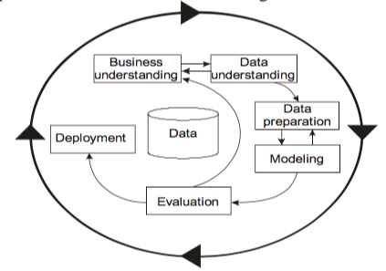
Standard process for data mining
For IoT problems, the most used data management (DM) methodology is cross-industry standard process for data mining (CRISP-DM) proposed by Chapman et al.
It's a process model that states the tasks that need to be carried out for successfully completing DM.
It’s a vendor-independent methodology divided into these six different phases:
1. Business understanding
2. Data understanding
3. Data preparation
4. Modelling
5. Evaluation
6. Deployment

Slide 27
Definition
Data mining is the process of discovering patterns, trends, and insights
from large datasets to extract actionable knowledge and make
informed decisions.
The standard data mining process consists of several sequential steps,
each aimed at transforming raw data into valuable information.
Importance:
Data mining enables organizations to uncover hidden patterns and
relationships in data, leading to improved decision-making, enhanced
efficiency, and competitive advantage.
Understanding the standard process in data mining is crucial for practitioners
and analysts to effectively extract insights and derive actionable intelligence
from data.

Slide 28
Steps in the Data Mining Process
Data Collection:
Gather relevant datasets from various sources, including databases, data warehouses,
and external sources.
Ensure data quality by cleaning, preprocessing, and integrating disparate datasets
to remove noise, inconsistencies, and missing values.
Data Exploration:
Explore the dataset to gain insights into its characteristics, distribution,
and relationships between variables.
Use descriptive statistics, data visualization techniques, and exploratory data analysis
(EDA) to identify patterns and anomalies.

Slide 29
Feature Selection/Engineering:
Select relevant features (variables) that are most predictive or influential for the mining task.
Engineer new features or transform existing ones to improve the performance of machine learning models.
Model Building:
Choose appropriate data mining techniques and algorithms based on the mining task and data characteristics.
Train and evaluate predictive models using training data, employing techniques such as classification, regression, clustering, or association analysis.

Slide 30
Model Evaluation:
Assess the performance of the trained models using evaluation metrics
such as accuracy, precision, recall, F1-score, or ROC curve.
Validate the model's generalization ability and reliability using
cross-validation or holdout validation techniques.
Deployment and Interpretation:
Deploy the trained model into production environments for
real-world applications.
Interpret the model's predictions and insights to derive actionable
recommendations and guide decision-making processes.

Slide 31
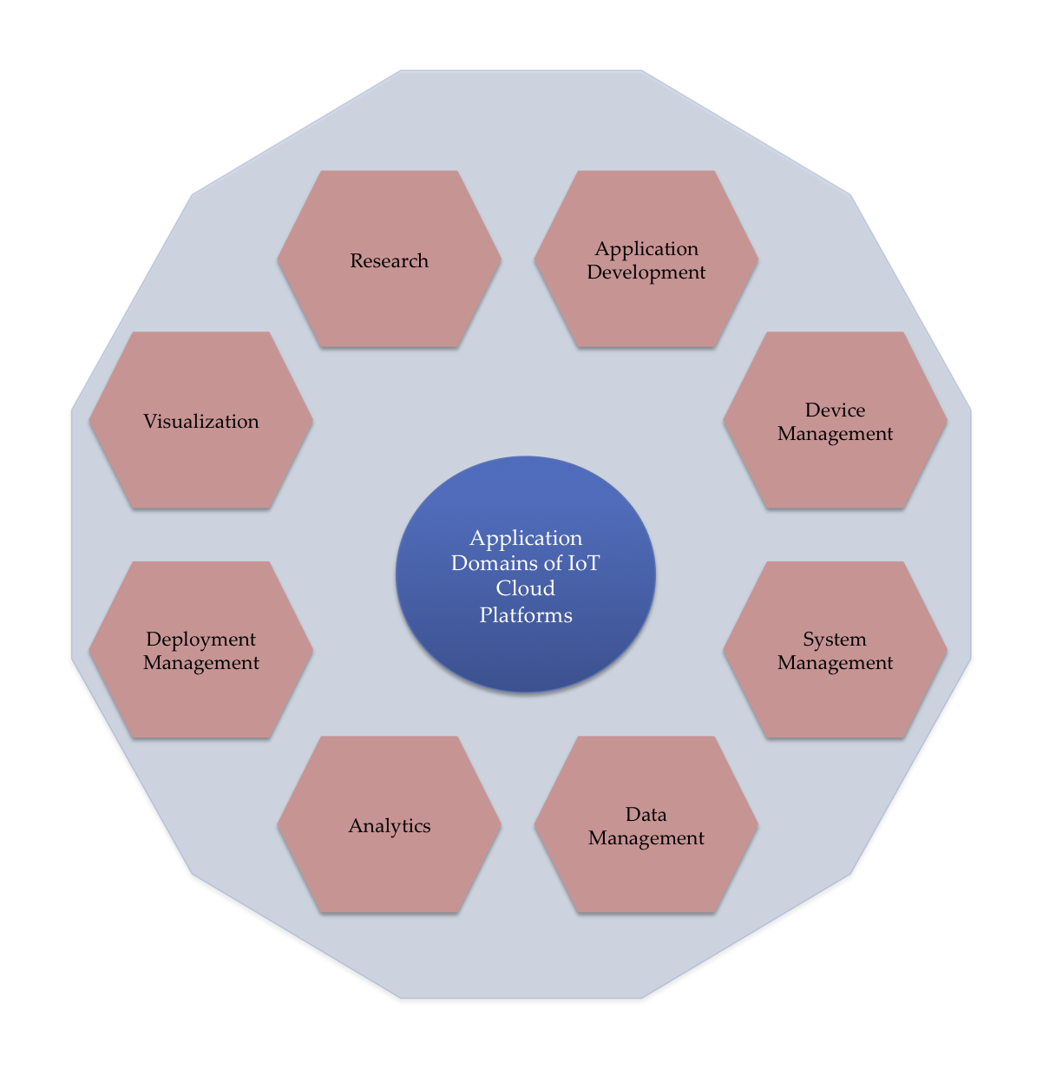
AI platforms and IoT platforms
There exist more than 30 cloud platforms in the global market, each targeting different IoT verticals and services.

Slide 32
IoT platforms are tailored to specific verticals such as industrial IoT (IIoT),
consumer IoT, healthcare IoT, and smart agriculture.
Similarly, AI platforms offer specialized services like computer vision,
natural language processing (NLP), predictive analytics, and
recommendation systems.
Services Offered:
IoT platforms provide a range of services including device management,
data analytics, connectivity solutions, and application development tools.
AI platforms offer services such as model training, inference, data
preprocessing, and integration with third-party APIs.

Slide 33
Major players in the IoT platform market include AWS IoT, Microsoft Azure
IoT, Google Cloud IoT, IBM Watson IoT, and Siemens MindSphere.
Leading AI platform providers comprise AWS AI/ML, Google Cloud AI,
Microsoft Azure AI, IBM Watson AI, and Nvidia AI.

Slide 34
IBM Watson IoT Platform:
Hosted by IBM, the platform provides device management; it uses the Message Queuing Telemetry Transport (MQTT) protocol to connect with IoT devices and applications.
It provides real-time scalable connectivity.
The data can be stored for a period and accessed in real time.
IBM Watson also provides Bluemix Platform-as-a-Service (PaaS) for analytics and visualizations.
We can write code to build and manage applications that interact with the data and connected devices.
It supports Python along with C#, Java, and Node.js.
Microsoft IoT-Azure IoT suite:
It provides a collection of preconfigured solutions built on Azure PaaS. It enables a reliable and secure bidirectional communication between IoT devices and cloud.
The preconfigured solutions include data visualization, remote monitoring, and configuring rules and alarms over live IoT telemetry.
It also provides Azure Stream Analytics to process the data in real time.
The Azure Stream Analytics allows us to use Visual Studio. It supports Python, Node.js, C, and Arduino, depending upon the IoT devices.

Slide 35
Google Cloud IoT:
The Google Cloud IoT provides a fully managed service for securely connecting and managing IoT devices. It supports both MQTT and HTTP protocols.
It also provides bidirectional communication between IoT devices and the cloud. It provides support for Go, PHP, Ruby, JS, .NET, Java, Objective-C, and Python.
It also has BigQuery, which allows users to perform data analytics and visualization.
Amazon AWS IoT:
The Amazon AWS IoT allows IoT devices to communicate via MQTT, HTTP, and Web Sockets.
It provides secure, bi-directional communication between IoT devices and the cloud.
It also has a rules engine that can be used to integrate data with other AWS services and transform the data.
Rules can be defined that trigger the execution of user code in Java, Python, or Node.js. AWS Lambda allows us to use our own custom trained models.

Slide 36
Introduction to Datasets
Datasets are the foundation of data-driven decision-making and analysis in various fields,
ranging from business and science to healthcare and technology.
A dataset is a structured collection of data points or observations, organized in a way that
facilitates analysis and interpretation.
Importance of Datasets:
Datasets serve as raw material for data analysis, machine learning, statistical modeling,
and other data-driven tasks.
They enable researchers, analysts, and businesses to derive insights, make predictions,
and solve complex problems by analyzing patterns and trends in data.

Slide 37
Characteristics:
Structure: Datasets may have different structures, such as tabular, hierarchical, relational, or unstructured, depending on the type of data they contain.
Size: Datasets can vary widely in size, from small datasets with a few hundred records to large datasets with millions or even billions of records.
Complexity: Datasets may contain simple data types like numbers and strings or more complex data types like images, text, time-series, or geospatial data.
Granularity: Datasets may be granular, consisting of fine-grained details at the individual level, or aggregated, summarizing data at higher levels of abstraction.

Slide 38
Types of Datasets
Tabular Datasets: These datasets are like spreadsheets, with rows representing individual
data points and columns representing attributes or features.
Image Datasets: Collections of digital images used for tasks such as recognizing objects
in photos or analyzing patterns.
Text Datasets: These contain textual data like articles, tweets, or chat logs, often used in
tasks such as sentiment analysis or language translation.
Time-Series Datasets: These datasets contain data points collected at regular intervals
over time, often used for forecasting or trend analysis.
Geospatial Datasets: These datasets represent spatial or geographical information, like
maps or GPS coordinates, used for applications such as navigation or urban planning.

Slide 39
TensorFlow
● TensorFlow is an open-source library for Deep Learning.
● Developed by the Google Brain team and released in November 2015.
● Version 1.0.0 was launched in February 2017
TensorFlow is built on the concept of tensors, which are multi-dimensional arrays or matrices. Tensors represent the fundamental data structure used in TensorFlow for storing and manipulating data during the computation process.
It provides a flexible and efficient framework for defining computational graphs, where nodes represent mathematical operations, and edges represent the flow of data (tensors) between nodes.

Slide 40
Install TensorFlow (Windows)
● Download Anaconda
● Create an environment with all must-have libraries.
$ conda create -n tensorflow python=3.5
$ activate tensorflow
$ conda install pandas matplotlib jupyter notebook scipy scikit
$ pip install tensorflow

Slide 41
Components:
TensorFlow Core: The core library provides essential functionalities for defining, training, and deploying machine learning models. It includes APIs for constructing computational graphs, defining loss functions, optimizing parameters, and executing operations.
TensorFlow Keras: Keras is an high-level API built on top of TensorFlow that provides an easy-to-use interface for building and training neural networks. It simplifies the process of defining model architectures, specifying layers, and configuring training parameters.

Slide 42
TensorFlow Estimators: Estimators are a high-level API for building machine learning models in TensorFlow. They encapsulate the model definition, training, evaluation, and prediction processes, making it easier to develop scalable and production-ready models.
TensorFlow Datasets: TensorFlow Datasets (TFDS) provides a collection of standard datasets for machine learning research and experimentation. It offers a convenient way to access and preprocess datasets for training and evaluation.
TensorFlow Serving: TensorFlow Serving is a dedicated server for deploying trained TensorFlow models in production environments. It enables efficient and scalable serving of machine learning models via RESTful APIs, making it easy to integrate models into production systems.

Slide 43
In TensorFlow, a program has two distinct components:
Computation graph is a network of nodes and edges. Here all of the data, variables, placeholders, and the computations to be performed are defined. TensorFlow supports three types of data objects: constants, variables, and placeholders.
Execution graph actually computes the network using a Session object. Actual calculations and transfer of information from one layer to another takes place in the Session object.

Slide 44
Computation Graph (Defining the Operations):
import tensorflow as tf
# Define placeholder nodes for input numbers
num1 = tf.placeholder(tf.float32, name='num1')
num2 = tf.placeholder(tf.float32, name='num2')
# Define addition operation
sum = tf.add(num1, num2, name='sum')
tf.placeholder creates placeholder nodes for the input numbers. Placeholders are used to feed actual data into the graph during the execution phase.
tf.add defines an addition operation that takes two input nodes (num1 and num2) and produces an output node (sum).

Slide 45
Execution Graph (Computing the Operations):
with tf.Session() as sess:
# Feed actual data into the graph using feed_dict
result = sess.run(sum, feed_dict={num1: 5.0, num2: 3.0})
print("Result:", result)
In this code:
We create a TensorFlow Session object (sess) to run the computation graph.
We use the sess.run() method to execute the graph and compute the value of the sum node. We provide actual values for the placeholders using the feed_dict argument.

Slide 46
Explanation
In the computation graph, we defined placeholders (num1 and num2) to hold the input numbers and an addition operation (sum) to compute their sum.
In the execution graph, we created a TensorFlow Session (sess) to run the computation graph. We used the sess.run() method to compute the value of the sum node, providing actual values for the input numbers.

Slide 47
Let's see the code to perform matrix multiplication in TensorFlow.
# import libraries and modules needed for the code
import tensorflow as tf
import numpy as np
# Data
# A random matrix of size [3,5]
mat1 = np.random.rand(3,5)
# A random matrix of size [5,2]
mat2 = np.random.rand(5,2)
#Computation Graph
A = tf.placeholder(tf.float32, None, name='A')
B = tf.placeholder(tf.float32, None, name='B')
C = tf.matmul(A,B)
#Execution Graph
with tf.Session() as sess:
result = sess.run(C, feed_dict={A: mat1, B:mat2})
print(result)

Slide 48
What is Keras ?
• Deep neural network library in Python
• High-level neural networks API
• Modular – Building model is just stacking layers and connecting computational
graphs
• Runs on top of either TensorFlow or Theano or CNTK
Why use Keras ?
• Useful for fast prototyping, ignoring the details of implementing backprop orwriting optimization procedure
• Supports Convolution, Recurrent layer and combination of both.
• Runs seamlessly on CPU and GPU
• Almost any architecture can be designed using this framework
• Open Source code – Large community support

Slide 49
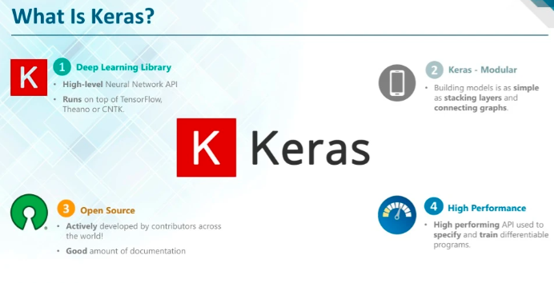

Slide 50
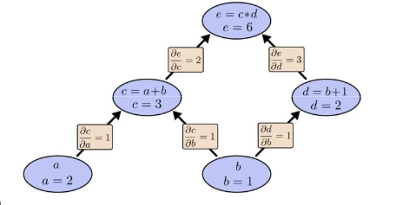
Working principle - Backend
• Computational Graphs
• Expressing complex expressions as
a combination of simple operations
• Useful for calculating derivatives
during backpropagation
• Easier to implement distributed
computation
• Just specify the inputs, outputs and
make sure the graph is connected e = c*d where, “c = a+b” and “d = b+1”
So, e = (a+b)*(b+1)
Here “a” ,“b” are inputs

Slide 51
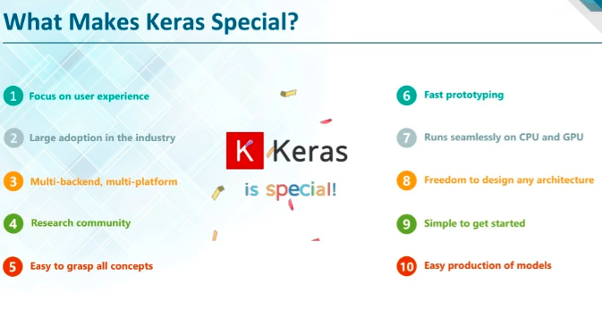

Slide 52
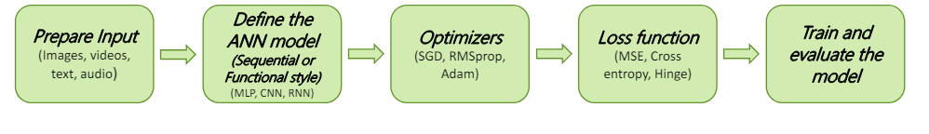
Implementing a neural network in Keras
• Five major steps
• Preparing the input and specify the input dimension (size)
• Define the model architecture and build the computational graph
• Specify the optimizer and configure the learning process
• Specify the Inputs, Outputs of the computational graph (model) and the Loss function
• Train and test the model on the dataset
Note: Gradient calculations are taken care by Auto – Differentiation and parameter updates are done automatically in the backend

Slide 53
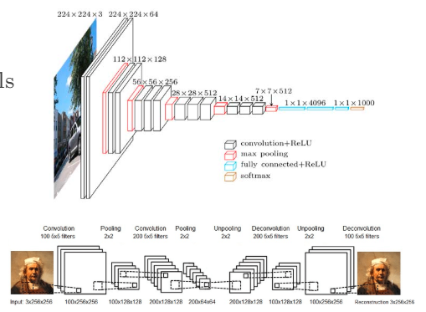
Keras models – Sequential
Sequential model
• Linear stack of layers
• Useful for building simple models
• Simple classification network
• Encoder – Decoder models

Slide 54
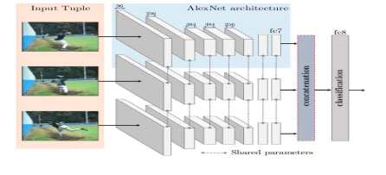
Keras models – Functional
•Functional Model
• Multi – input and Multi –output models
• Complex models which forks into 2 or more branches
• Models with shared (Weights) layers

Slide 55
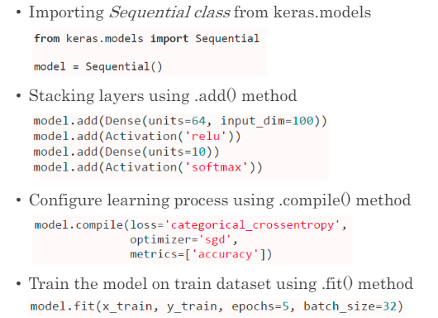
Procedure to implement an ANN in Keras
Procedure to implement an ANN in Keras

Slide 56
Dataset Examples
MNIST Dataset:
Description: The MNIST dataset contains 28x28 grayscale images of handwritten digits (0-9), along with their corresponding labels.
Use Case: Handwritten digit recognition, classification algorithms, image processing.
CIFAR-10 Dataset:
Description: The CIFAR-10 dataset consists of 60,000 32x32 color images in 10 classes, with 6,000 images per class.
Use Case: Object recognition, image classification, deep learning.
IMDB Reviews Dataset:
Description: This dataset contains a collection of movie reviews from the IMDB website, along with their corresponding sentiment labels (positive or negative).
Use Case: Sentiment analysis, natural language processing (NLP), text classification.

Slide 57
Titanic Dataset:
Description: The Titanic dataset contains information about passengers aboard the Titanic, including features like age, gender, ticket class, fare, and survival status.
Use Case: Predictive modeling, survival analysis, classification algorithms.
Iris Dataset:
Description: The Iris dataset consists of measurements of various iris flowers, including sepal length, sepal width, petal length, and petal width, along with their species labels.
Use Case: Classification, pattern recognition, clustering algorithms.

Slide 58
Boston Housing Dataset:
Description: This dataset contains housing prices and attributes for various neighborhoods in Boston, including features like crime rate, average number of rooms, and proximity to employment centers.
Use Case: Regression analysis, predictive modeling, housing market trends.
Breast Cancer Wisconsin (Diagnostic) Dataset:
Description: The Breast Cancer Wisconsin dataset contains features computed from a digitized image of a fine needle aspirate (FNA) of a breast mass, along with diagnosis labels (malignant or benign).
Use Case: Classification, tumor diagnosis, medical image analysis.
Wine Dataset:
Description: The Wine dataset contains measurements of various chemical compounds found in wines, along with their respective cultivar labels.
Use Case: Classification, pattern recognition, quality assessment.

Slide 59
Data Access and distributed processing for IOT
Data access and distributed processing are crucial aspects of handling IoT (Internet of Things) data efficiently due to the sheer volume, velocity, and variety of data generated by IoT devices. Here's an overview of data access and distributed processing for IoT:

Slide 60
Data Access:
Data Collection: IoT devices generate vast amounts of data from sensors, actuators, and other sources. Efficient data collection mechanisms are essential for gathering this data in real-time or at regular intervals.
Data Ingestion: Once collected, IoT data needs to be ingested into a centralized system or platform for further processing and analysis. This may involve protocols like MQTT, CoAP, or HTTP for communication between devices and the data processing infrastructure.
Data Storage: IoT data is typically stored in distributed databases or data lakes that can handle large volumes of data and support scalable storage solutions. NoSQL databases like Apache Cassandra or key-value stores like Redis are commonly used for storing IoT data.
Data Streaming: In addition to batch processing, IoT data often arrives in continuous streams. Stream processing frameworks like Apache Kafka or Apache Flink enable real-time processing and analysis of streaming data from IoT devices.

Slide 61
Distributed Processing:
Parallel Processing:
Involves breaking tasks into smaller sub-tasks for simultaneous execution by multiple processors.
Handles large IoT data volumes efficiently by distributing workload across multiple units.
Examples include Apache Spark and Apache Hadoop for analyzing large-scale IoT datasets.
Edge Computing:
Brings computational resources closer to IoT devices, enabling local data processing at the network edge.
Reduces latency and bandwidth by analyzing data directly on devices before transmitting to the cloud.
Facilitates real-time decision-making in IoT applications

Slide 62
Fog Computing:Extends edge computing with intermediate fog nodes between devices and the cloud.Fog nodes perform data processing closer to devices, reducing the need for distant cloud servers.Balances local edge processing and centralized cloud processing, optimizing resource usage.
Distributed Analytics:Utilizes distributed machine learning and analytics algorithms for insights from IoT data.Enables scalable analytics across multiple nodes, efficiently processing large data volumes.Techniques like parallelized deep learning or distributed clustering extract meaningful insights for decision-making.

Slide 63
To effectively manage and utilize this diverse data, it is stored and made available in various formats, including:
Text: Plain text files are a simple and widely compatible format for storing IoT data. Each line typically represents a single data record, with values separated by delimiters such as commas or tabs. Text files are easy to create, read, and manipulate using standard text editors or programming languages.
CSV (Comma-Separated Values): CSV files are structured text files where each line represents a single data record, and values within each record are separated by commas. CSV is a popular format for storing tabular data, as it can be easily imported into spreadsheet software like Microsoft Excel or Google Sheets and processed using data analysis tools.

Slide 64
JSON (JavaScript Object Notation): JSON is a lightweight data interchange format that is widely used for transmitting and storing structured data. It is human-readable and easy to parse, making it well-suited for representing hierarchical data structures commonly found in IoT applications. JSON is often used for web-based APIs and data storage in NoSQL databases like MongoDB.
HDF5 (Hierarchical Data Format version 5): HDF5 is a versatile and efficient file format for storing and organizing large volumes of scientific data. It supports hierarchical data structures, metadata, and compression, making it suitable for storing multidimensional arrays, time-series data, and other complex data types commonly encountered in IoT applications.
SQL Data: SQL databases, such as MySQL, PostgreSQL, or SQLite, are commonly used for storing structured IoT data in relational tables. SQL provides a powerful querying language for retrieving and manipulating data, making it well-suited for applications that require complex data analysis and reporting capabilities.

Slide 65
Text files in python, SQL data, HDF5
Reading Text Files:
with open('filename.txt', 'r') as file:
data = file.read()
Writing to Text Files:
with open('filename.txt', 'w') as file:
file.write('Hello, world!')

Slide 66
SQL DATA
Connecting to a Database (using SQLite as an example)
import sqlite3
# Connect to database
conn = sqlite3.connect('example.db')
# Create a cursor
objectcursor = conn.cursor()
Executing SQL Queries:
# Execute SQL
querycursor.execute("SELECT * FROM table_name")
# Fetch
datadata = cursor.fetchall()

Slide 67
HDF5 Files:
Reading HDF5 Files:
import h5py
# Open HDF5 file
with h5py.File('filename.h5', 'r') as file:
data = file['dataset_name'][:]
Writing to HDF5 Files:
import h5py
# Create HDF5 file
with h5py.File('filename.h5', 'w') as file:
# Create dataset
dataset = file.create_dataset('dataset_name', data=my_data)

